Slide 1

Towards an Automated Defense:
A Novel Framework for Log-Based Threat Detection and IP Remediation in AWS
Project Description
Presented By: Suhaib Kashif & Ali Sher Afzal
Affiliation: Department of Computer and Software Engineering, Information Technology University (ITU)

Slide 2



EXECUTIVE SUMMARY
Transforming Threat Response: From Manual to Automated
Traditional security relies on time-consuming manual log analysis, creating a dangerous "latency gap" where attackers can operate freely for extended periods.
Manual & Slow
Automated & Fast
Self-Healing & Secure
Human-driven analysis leads to significant delays.
Event-driven architecture eliminates human latency.
Rapid remediation creates a robust, proactive defense.
Our objective was to eliminate the "human in the loop" for repetitive blocking tasks, reducing response time from hours to mere seconds. We achieved a "Self-Healing" network capability with an average remediation time of approximately 1.2 seconds.

Slide 3
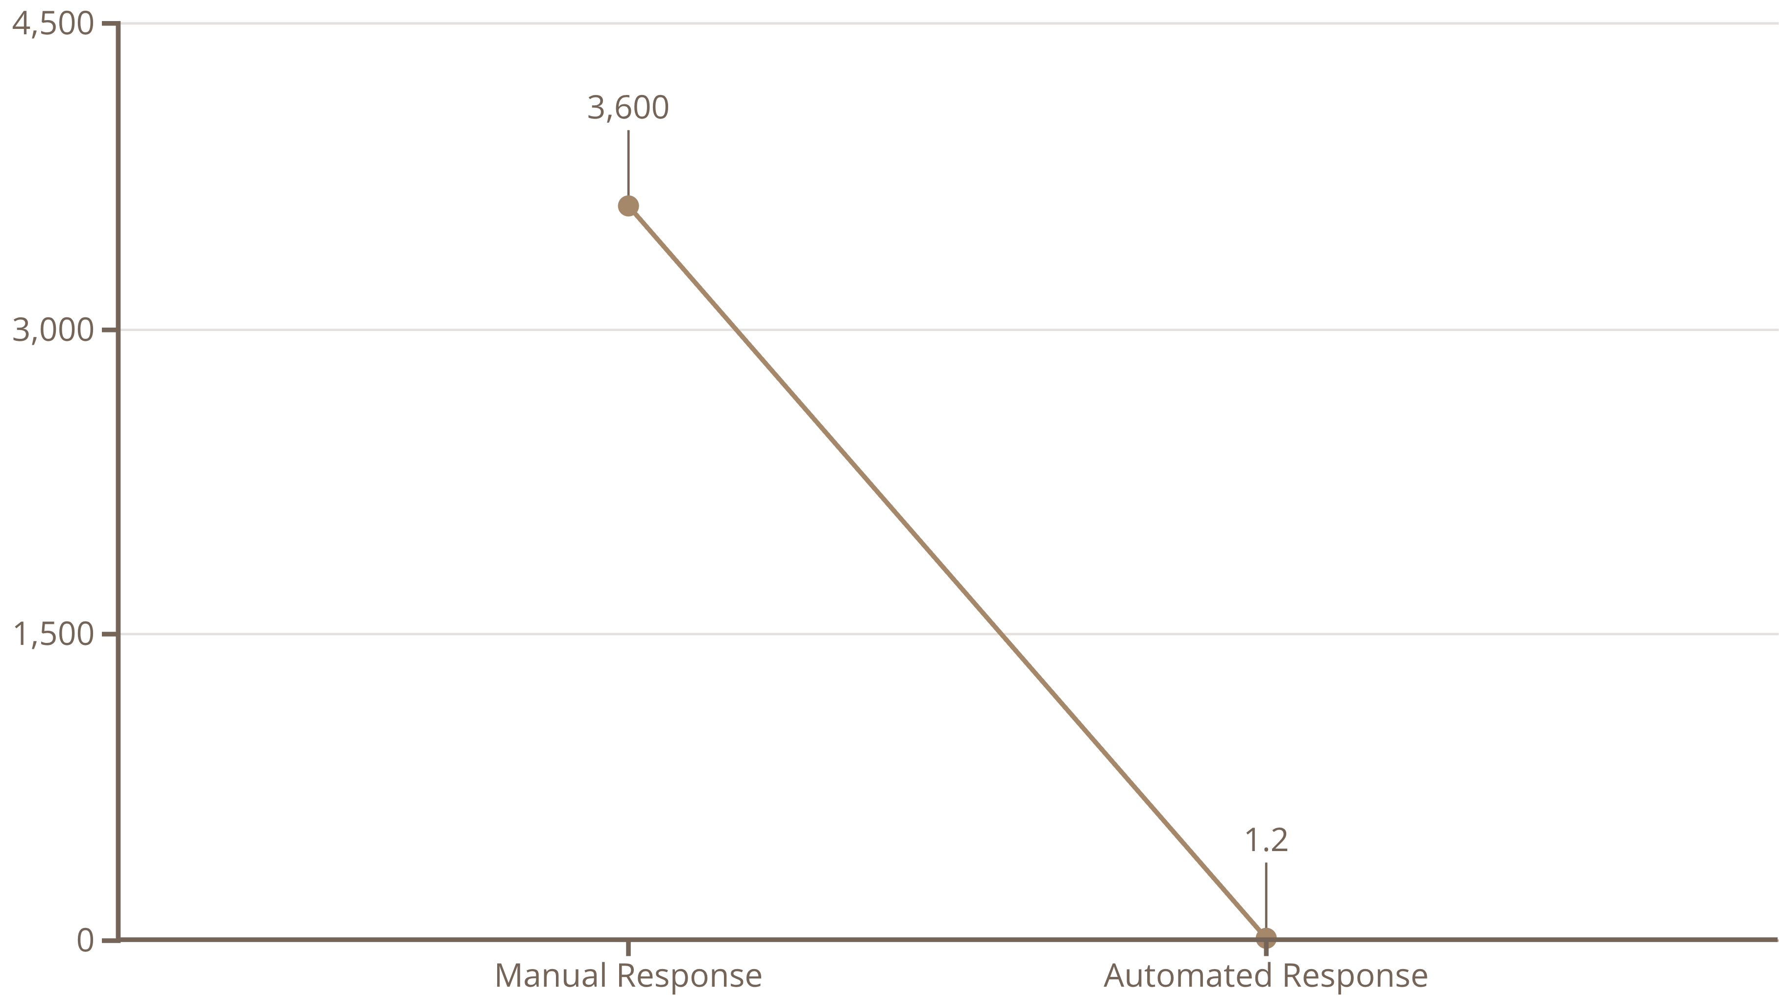
PROBLEM STATEMENT
The Critical Latency Gap in Cybersecurity
A critical time delay exists between the detection of a threat (log entry) and its mitigation (blocking the malicious IP address). This "latency gap" is a major vulnerability.
Human Limitations & Errors
Scalability Barriers
Analysts cannot manually analyze millions of logs in real-time.
Manual responses simply cannot scale with the overwhelming volume of automated botnet attacks.
High-stress incidents often lead to misconfiguration errors, exacerbating risks.
Traditional methods are quickly overwhelmed by modern threats.
This chart clearly illustrates the dramatic difference in response time, highlighting why automation is crucial for effective defense.
This chart clearly illustrates the dramatic difference in response time, highlighting why automation is crucial for effective defense.

Slide 4





HIGH-LEVEL OVERVIEW
Event-Driven, Serverless Architecture
Our design philosophy embraces a fully serverless, event-driven, and highly scalable approach to threat detection and remediation.
Attack Path
Monitoring Layer
Detection Pipeline
Response Pipeline

Slide 5
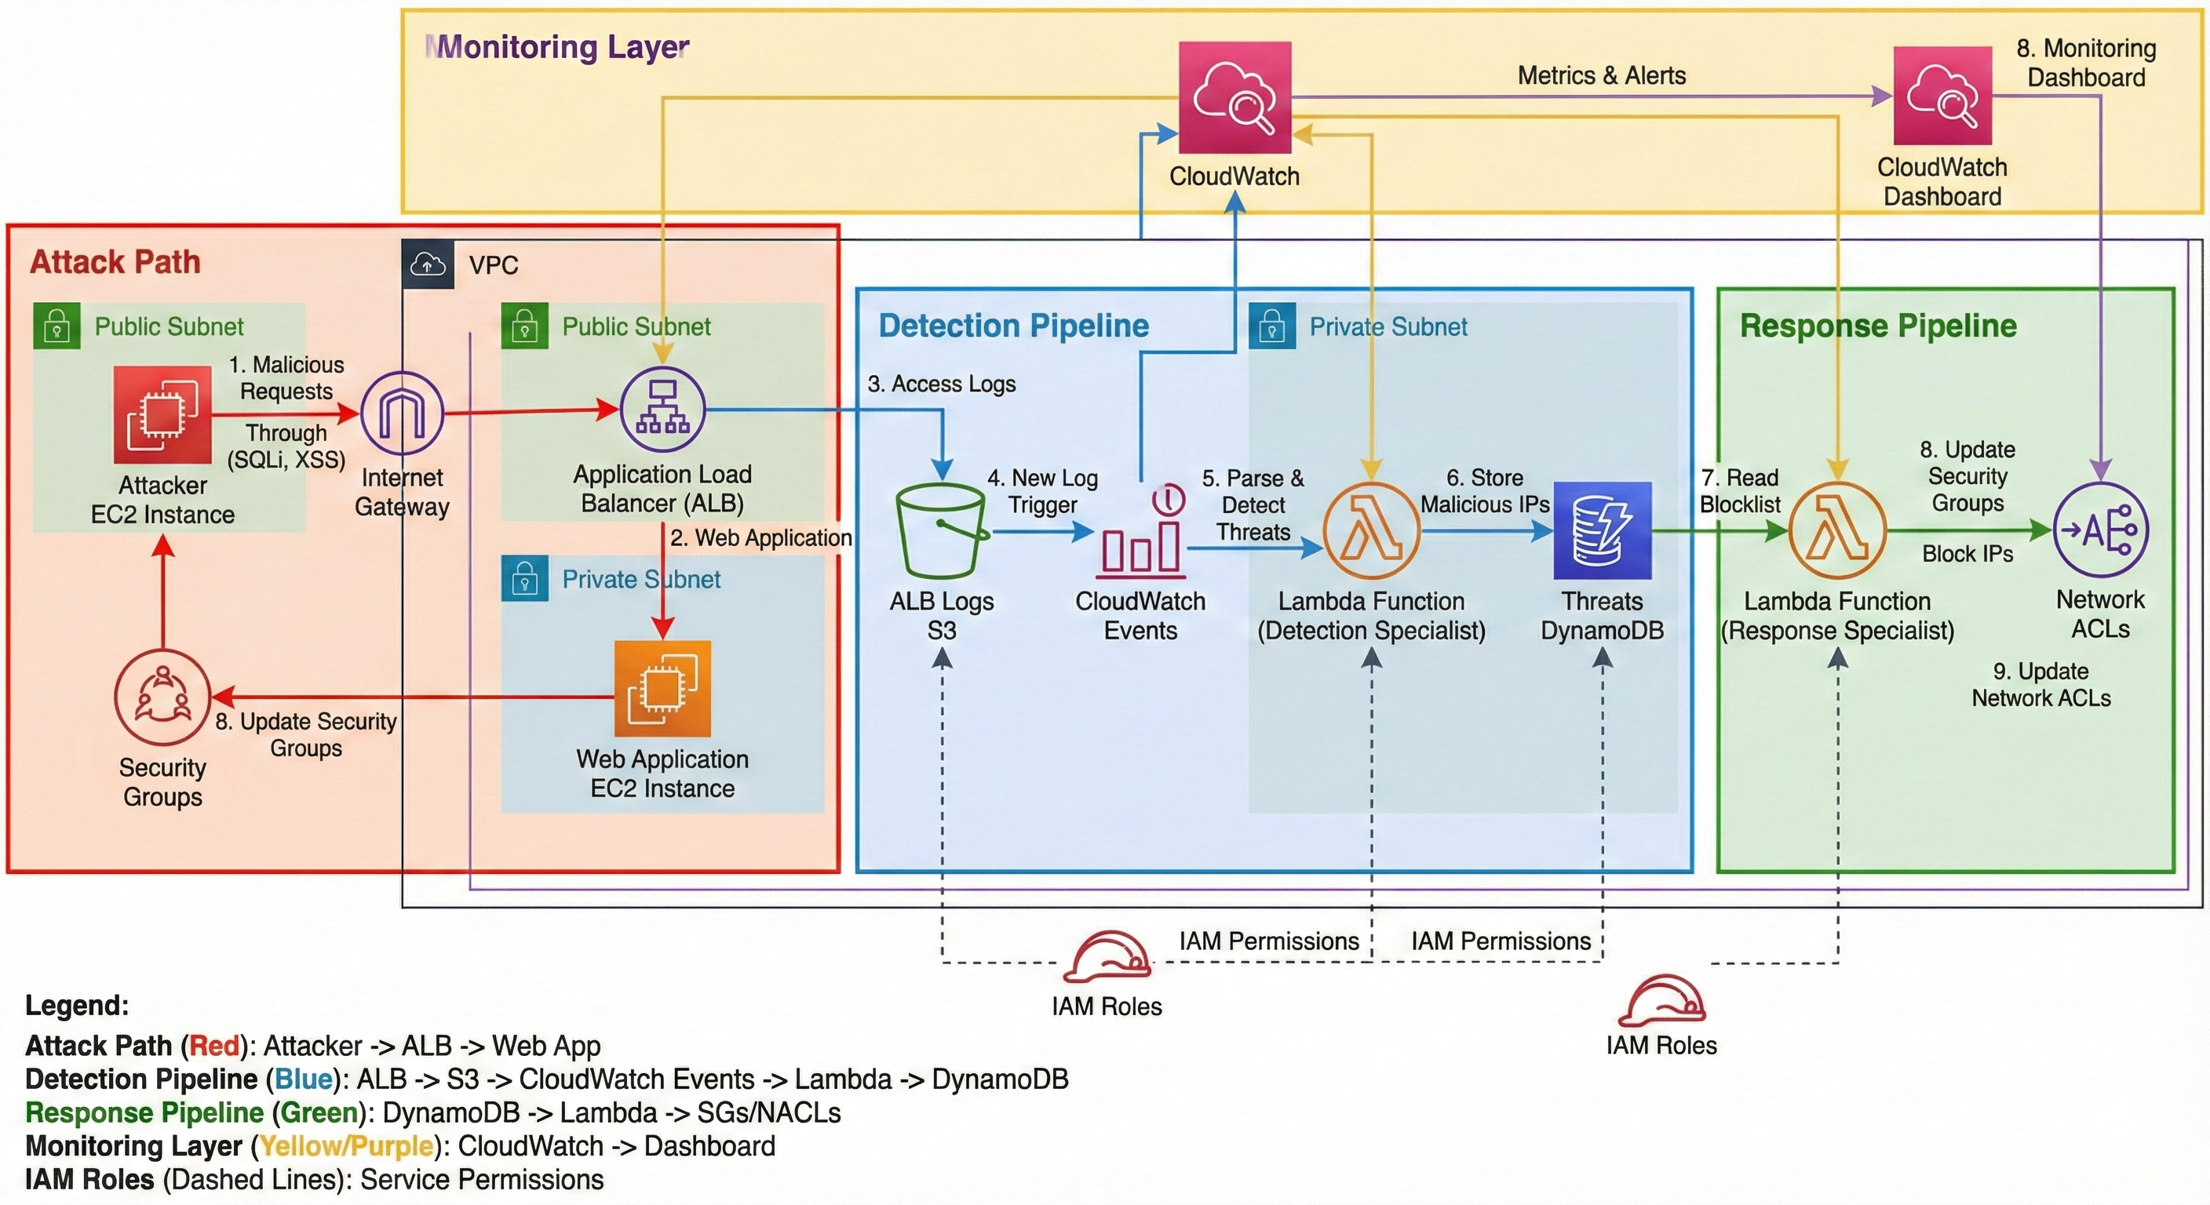

Architectural Diagram
Attack Path (Red): Represents the infiltration vector used by malicious actors.
Detection Pipeline (Blue): Focuses on analysis and identification of threats from logs.
Response Pipeline (Green): Executes automated remediation actions.
Monitoring Layer (Yellow): Provides continuous visibility and metrics for system
health and security.

Slide 6
ARCHITECTURAL DEEP DIVE
The Attack Path (Red Flow)
This path illustrates how a malicious request penetrates the network, targeting vulnerable web applications.
Infiltration Point
Ingress via ALB
Exploiting Vulnerability
An attacker sends malicious requests (e.g., SQL Injection, Cross-Site Scripting) from an external EC2 instance.
Traffic passes through the Internet Gateway (IGW) to the Application Load Balancer (ALB).
The ALB forwards the request to the Web Application EC2, initiating the exploit.

Slide 7
ARCHITECTURAL DEEP DIVE
The Detection Pipeline (Blue Flow)
This pipeline demonstrates how passive logs are actively processed to identify and flag threats.
01
02
03
Log Ingestion
Event Trigger
Threat Analysis
ALB generates access logs containing Requester IP and URI, pushing them to a designated S3 bucket.
An s3:ObjectCreated event triggers CloudWatch Events, which then invokes the "Detection Specialist" Lambda function.
The Lambda function decompresses logs and uses Regular Expressions (Regex) to match known malicious signatures (e.g., "UNION SELECT", "

Slide 8
ARCHITECTURAL DEEP DIVE
The Response Pipeline (Green Flow)
Once a threat is detected, the response pipeline ensures immediate and automated remediation.
1
2
3
Stream Processing
Stateful Blocking
Stateless Blocking
A "Response Specialist" Lambda is triggered via DynamoDB Streams only when a new threat is committed to the table.
The Lambda updates the EC2 Security Group to explicitly deny ingress traffic from the malicious IP, protecting instances directly.
Concurrently, the Lambda updates the Subnet Network ACL (NACL) to block traffic at the perimeter, preventing it from reaching any instance within the subnet.

Slide 9
IMPLEMENTATION DETAILS
Robust Security Controls and IaC
Our solution prioritizes robust implementation through Infrastructure as Code (IaC) and the principle of Least Privilege.
Infrastructure as Code (IaC)
IAM & Least Privilege
All AWS resources are deployed and managed programmatically, ensuring consistency, version control, and rapid deployment capabilities.
Detection Role: Strictly limited to s3:GetObject for log retrieval and dynamodb:PutItem for threat recording.
Response Role: Granted ec2:AuthorizeSecurityGroupIngress and ec2:CreateNetworkAclEntry, with permissions explicitly scoped to project-specific resource tags.
Eliminates manual configuration errors and facilitates auditability.
Regex Logic for Threat Identification
Our Python-based parsing module uses highly optimized Regular Expressions to instantaneously identify common attack vectors like SQL Injection (e.g., "OR 1=1") and Cross-Site Scripting (e.g., "<script>").

Slide 10
PERFORMANCE METRICS
Achieving "Self-Healing" Network Capability
The automated framework drastically reduces the Mean Time to Respond (MTTR), fundamentally changing our security posture.
1.2
0
100%
Average Response Time
Human Intervention
Serverless Scalability
Reduced MTTR from hours to an average of 1.2 seconds.
Eliminated manual configuration errors during high-stress attack scenarios.
Components like Lambda and DynamoDB automatically handle traffic spikes.
This rapid, automated response ensures that attacks are mitigated almost as soon as they are detected, providing a near real-time defense.

Slide 11
CONCLUSION & FUTURE WORK
Beyond Traditional Security Appliances
This framework successfully demonstrates a cost-effective, scalable, and highly performant alternative to traditional commercial security appliances.
1
2
CONCLUSION
FUTURE WORK
We have proven the efficacy of an automated, serverless approach to IP-based threat remediation, drastically improving response times and reducing operational overhead.
Integrate with AWS WAF for enhanced Layer 7 filtering and more sophisticated attack prevention.
Implement Machine Learning (via Amazon SageMaker) to detect zero-day anomalies and emerging threats beyond static signature matching.
By continually evolving this framework, we aim to build even more intelligent and resilient cloud security systems.

